Slide 1
Periodontal health: A foundation for oral health
Presented by
Dr.Sharmila Khopade
Periodontist and Implantologist

Slide 2
Contents
What is Periodontitis
When do you think you should refer
Which all aspects you should look for
What do you tell patient when you refer
How do you document it

Slide 3
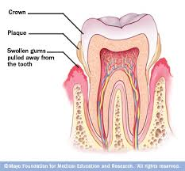
Periodontitis

Slide 4
Signs and symptoms
Red or swollen gingiva
Bleeding on probing
Pocket depth
Recession
mobility

Slide 5
BPE score

Slide 6
Key points
BPE not around the implants
After we do intial therapy on recall visit only do six point charting with sites having scores with 3 and above
In furcation areas always probe horizontally to check defect
Radiographs must for score3, 4 and above

Slide 7
GINGIVAL RECESSION
MOBILITY
GINGIVAL ENLAERGEMENT
TRAUMA FROM OCCLUSION

Slide 8
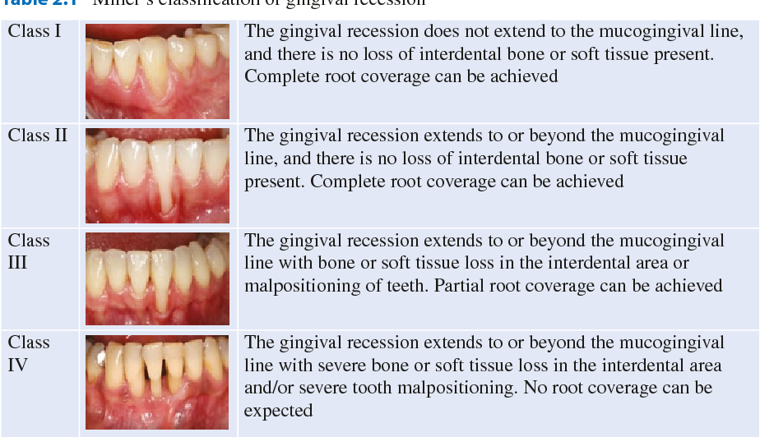
Gingival recession

Slide 9
Furcation involvement

Slide 10
Pigmentation on gingivia

Slide 11
High frenal attachment

Slide 12
Tongue tie

Slide 13
Labial frenum causing recession

Slide 14
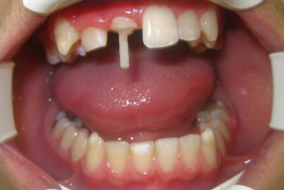
Insufficient crown height or subgingival crown margin

Slide 15
Epulis/ginigival swelling

Slide 16
Modifying factors
Patients with uncontrolled diabetes
Patients with high blood pressure
Smokers
Leukemia, anemia or vitamin deficiencies
Females with hormonal imbalance
Local factors
Complicated prosthesis
Severe crowding /malocclusion
Localised tooth mobility without obvious cause

Slide 17
Treatment procedures

Slide 19
Code 1 & 2
OHI
Scaling
Code 3
No modifying factor: RSD
Modifying factor: refer
Code 4
No modifying factor: refer
Modifying factor: refer

Slide 21
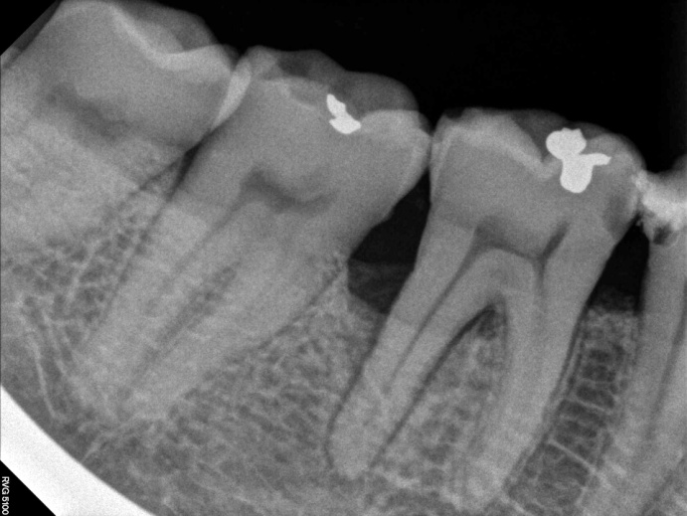
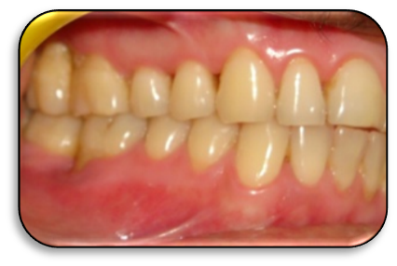

Slide 25
Surgeries

